Slide 1
Problem statement 35 - Intelligent Classification of Rural Infrastructure Projects
CAPSTONE PROJECT
Presented By:
Vrishabh Jawa - Galgotias University - CSE (Data Science)

Slide 2
OUTLINE
Problem Statement
Proposed System/Solution
System Development Approach (Technology Used)
Algorithm & Deployment
Result (Output Image)
Conclusion
Future Scope
References

Slide 3
Problem Statement
The Pradhan Mantri Gram Sadak Yojana (PMGSY) is a flagship rural development program in India, initiated to provide all-weather road connectivity to eligible unconnected habitations. Over the years, the program has evolved through different phases or schemes (PMGSY-I, PMGSY-II, RCPLWEA, etc.), each with potentially distinct objectives, funding mechanisms, and project specifications. For government bodies, infrastructure planners, and policy analysts, efficiently categorizing thousands of ongoing and completed projects is crucial for effective monitoring, transparent budget allocation, and assessing the long-term impact of these schemes. Manual classification is time-consuming, prone to errors, and scales poorly. Your specific task is to design, build, and evaluate a machine learning model that can automatically classify a road or bridge construction project into its correct PMGSY_SCHEME based on its physical and financial characteristics.

Slide 4
Proposed Solution
The proposed system aims to address the challenge of classifying rural infrastructure projects under schemes like PMGSY-I, PMGSY-II, and RCPLWE. This classification assists in project tracking, reporting, and informed decision-making. The solution is composed of the following components:
Data Collection: Project data was collected in CSV format from AI Kosh and uploaded to IBM Cloud Object Storage, which integrates with Watsonx.ai Studio for analysis and model building.
Data Preprocessing: Data cleaning, transformation, and feature engineering were done using IBM Watsonx.ai Studio Notebooks (Python). Tasks included handling missing values, encoding categorical variables, and preparing the dataset for machine learning.
Machine Learning Algorithm: IBM Watson AutoAI was used to automatically train and evaluate multiple classification models such as Logistic Regression, Random Forest, and Gradient Boosting. The model with the highest performance was selected and deployed using IBM Watson Machine Learning.
Deployment: The trained model was deployed on IBM Watsonx.ai Runtime as a REST API endpoint. This allows real-time classification of new project data directly from the cloud.
Evaluation: Model performance was evaluated using built-in AutoAI metrics such as Accuracy, Precision, Recall, and F1-Score. The model was fine-tuned based on performance feedback and deployment test results.

Slide 5
System Approach
This project follows a structured IBM Cloud–based workflow to classify rural infrastructure projects efficiently using cloud tools and machine learning.
System Requirements
IBM Cloud Lite Account
IBM Watsonx.ai Studio (for development)
IBM Cloud Object Storage (for dataset upload)
IBM Watsonx.ai Runtime (for deployment)
Web browser (Chrome) for accessing services
Libraries Used in Watson Studio Notebook
pandas – Data handling and manipulation
numpy – Numerical operations
scikit-learn (sklearn) – ML model training and evaluation
matplotlib / seaborn – Visualization

Slide 6
Algorithm & Deployment
The classification system was implemented using IBM Watson AutoAI. The following outlines the algorithm selection, data inputs, training, and prediction process.
Algorithm Selection:
IBM Watson AutoAI was used to automatically compare and rank several classification algorithms. The best model was selected from:
Logistic Regression
Random Forest
Gradient Boosting
This approach was chosen because:
It is suitable for categorical classification tasks like scheme prediction (PMGSY-I, II, RCPLWE)
It automates model selection and tuning
It ensures objective and performance-based model choice

Slide 7
Algorithm & Deployment
Data Input: These features influence how projects are planned and executed under different PMGSY schemes.
State Name
District Name
Number of Roads Sanctioned
Length of Roads Sanctioned
Cost of Work Sanctioned
Road Works Completed
Length Completed
Bridges Completed
Expenditure Occurred
Balance Work Remaining (count & length)

Slide 8
Algorithm & Deployment
Training Process:
Data was uploaded to IBM Cloud Object Storage and accessed in Watsonx.ai Studio Notebook.
Preprocessing included:
Dropping irrelevant columns
Handling missing values
Encoding categorical fields like state and district
AutoAI handled model training, hyperparameter tuning, and cross-validation automatically
Prediction Process:
The best model was deployed using IBM Watsonx.ai Studio.
A REST API endpoint was generated to allow classification of new project data.
Input: JSON object with project attributes
Output: Predicted scheme type (e.g., "PMGSY-II")
The model supports real-time usage for administrators and analysts.

Slide 9
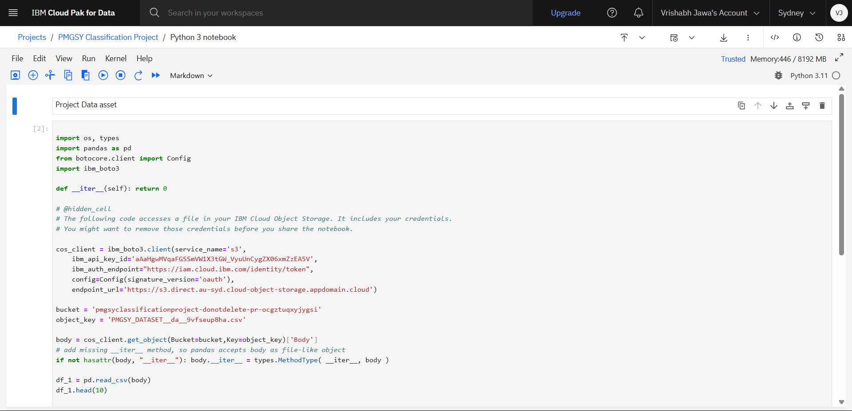
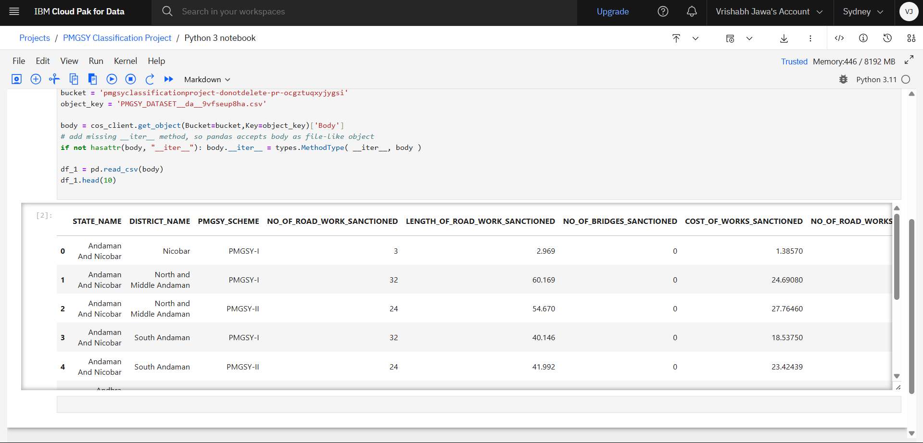
Result
IBM Watsonx.ai Studio (Notebook)

Slide 10
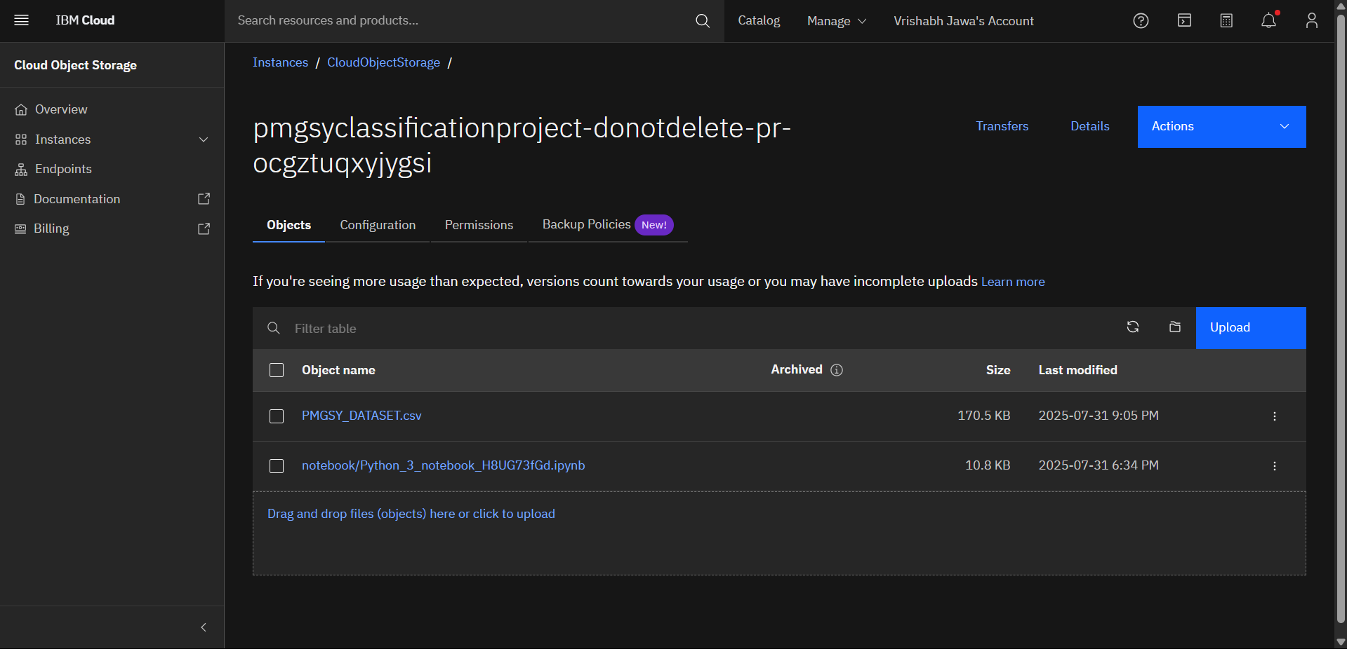
Result
IBM Cloud Object Storage (Storage)

Slide 11
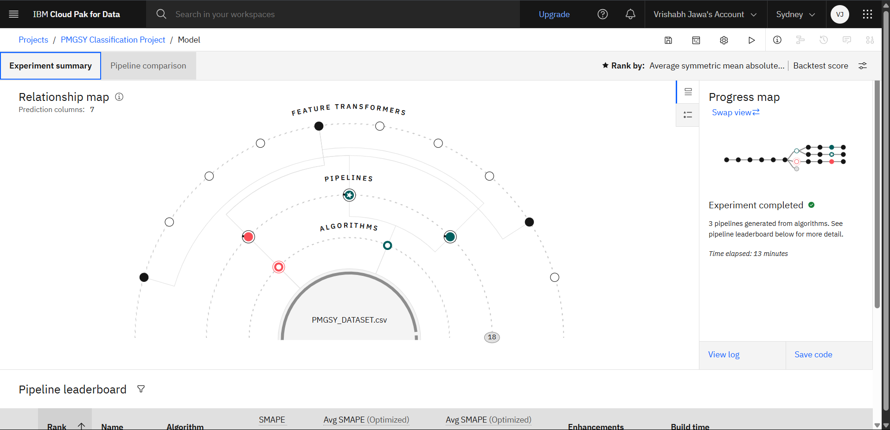
Result
IBM Watsonx.ai Studio – Auto ai (Model)

Slide 12
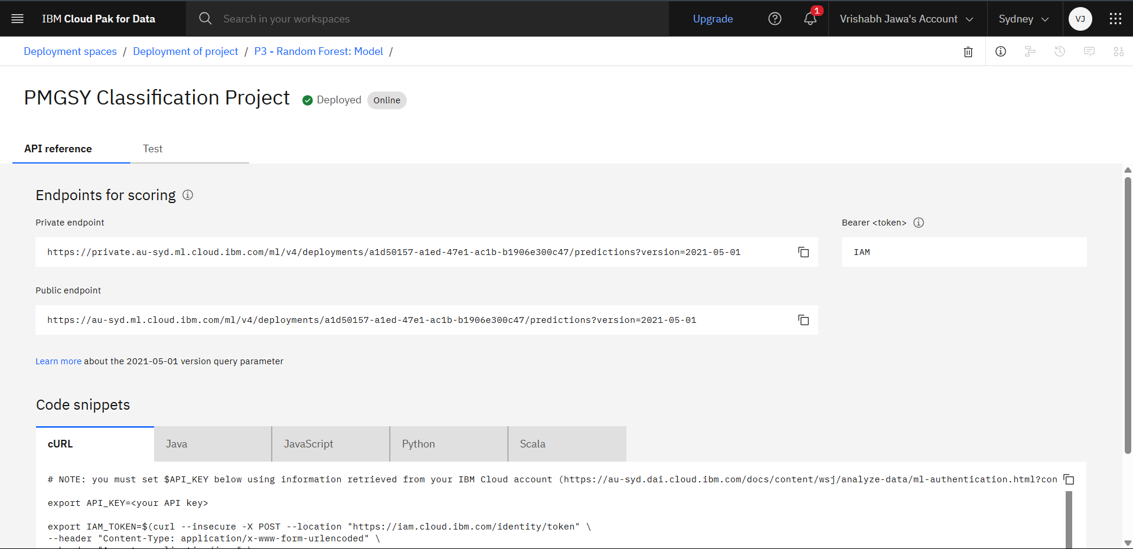
Result
IBM Watsonx.ai Runtime (Deployment)

Slide 13
Conclusion
The project successfully classified rural infrastructure projects into PMGSY-I, II, and RCPLWE using IBM Watson AutoAI and deployed the model via Watson Machine Learning.
Findings:
Achieved accurate classification using AutoAI
Enabled real-time prediction via REST API
Challenges:
Data cleaning and encoding complexity
IBM Cloud Lite limitations in customization
Improvements:
Add more features (e.g., geography, weather)
Enhance UI/API interaction
Impact:
Supports better rural project monitoring and decision-making

Slide 14
Future scope
Enhancements
Include additional features like terrain type, funding status, or work delay reasons
Integrate real-time data from on-ground monitoring apps or sensors
Algorithm Optimization
Use advanced models (e.g., XGBoost, neural networks) in Watson Studio Notebooks
Explore AutoAI custom pipelines or Watson OpenScale for model explainability
Scalability
Expand the system to cover more schemes, states, or infrastructure types (e.g., bridges, schools)
Deploy in other development programs like Smart Cities or Jal Jeevan Mission
Tech Integration
Integrate with dashboards for real-time visualization
Future use of Edge AI and IoT for on-site updates and predictions

Slide 15
References
IBM Cloud Documentation
IBM Watson Studio
PMGSY Official Portal
IBM AutoAI Overview
IBM Watson Machine Learning
Dataset Source – AI kosh

Slide 16
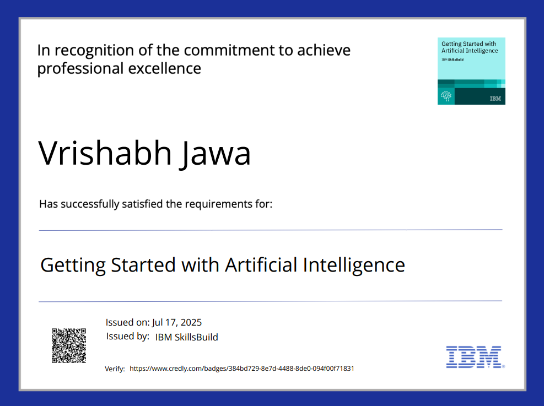
IBM Certifications
Getting started with AI

Slide 17
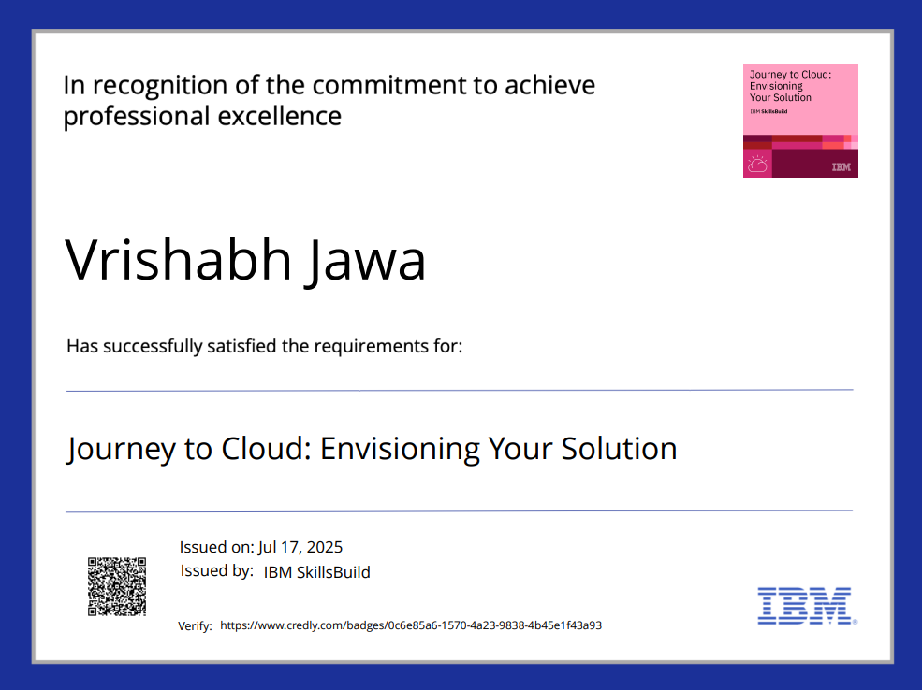
IBM Certifications
Journey to Cloud

Slide 18
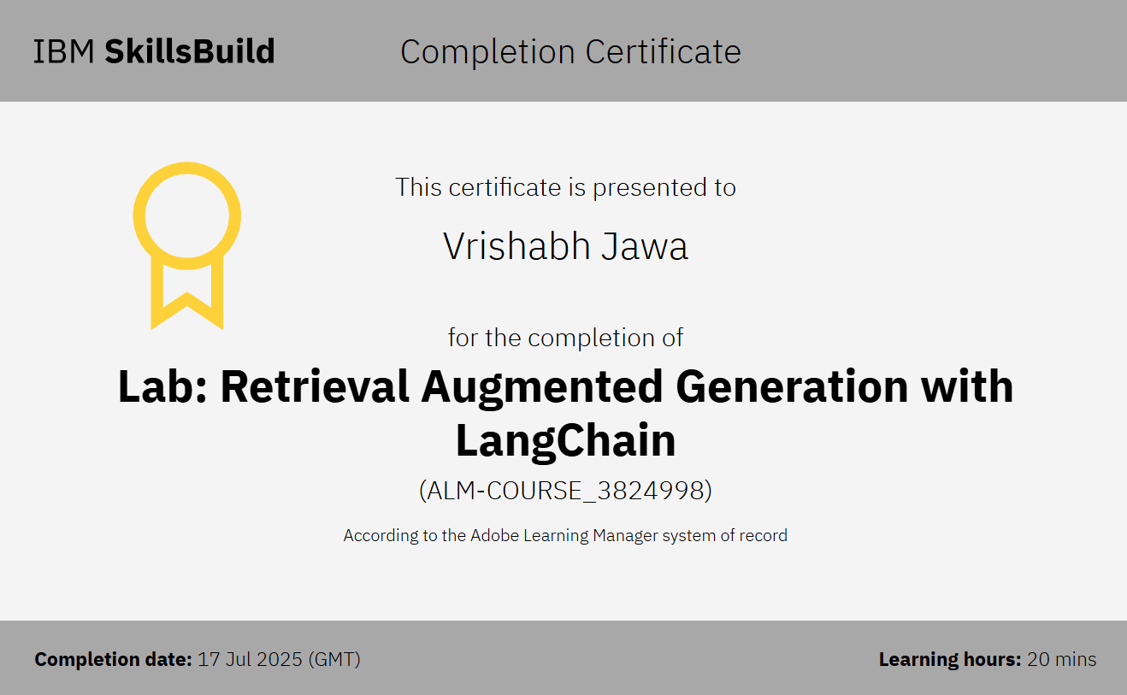
IBM Certifications
RAG Lab

Slide 19
THANK YOU

